Slide 1
WORK ORDER MANAGEMENT ANALYSIS
Divya ramesh

Slide 2
PROBLEM STATEMENT
&
HYPOTHESIS
Objective:
Work order activities in a service management system are not being tracked efficiently which results in delays in problem resolution, customer dissatisfaction, and inefficiencies.
Expected outcome: Help improve work order management, optimize completion times, and enhance operational efficiency.
Research Questions to address:
Task Frequency and Resource Allocation
Client-Specific Task Patterns
Cross-Client Issue Similarity
High-Effort Task Improvement
Task Duration Optimization

Slide 3
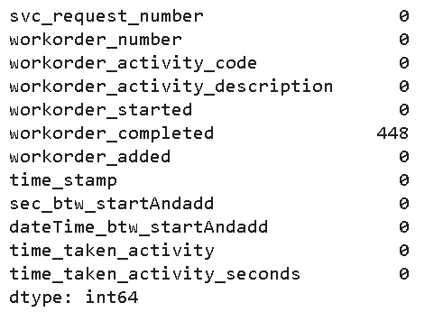
Dataset Stats
DATA PRE-PROCESSING & CLEANING:
Removed duplicates
Outlier detection
Handled missing / null values
Invalid data removal
Description | Before cleaning | After cleaning | Percentage cleaned
Data shape | (206,058, 8) | (101090, 12) | 49.1%
DATA TRANSFORMATION
Converted time series data into Datetime format
FEATURE ENGINEERING
1. Difference between start and added time
2. Difference between start and completed time
3. Extracting year, month, date and time
DATA VALIDATION:
Separated data into two to check for negative total seconds and remove invalid rows

Slide 4
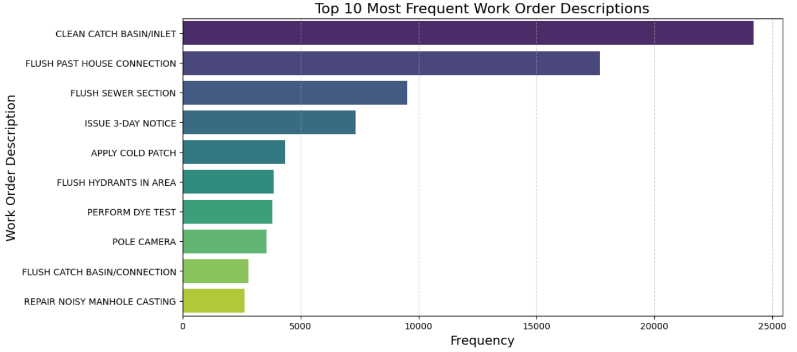
FREQUENCY ANALYSIS
Use case definition: Identifying the most common work orders to optimize resource allocation and staffing
Recommended Insights: Implement predictive staffing for high-frequency tasks based on historical patterns and seasonality analysis
Most Frequent Work Orders

Slide 5
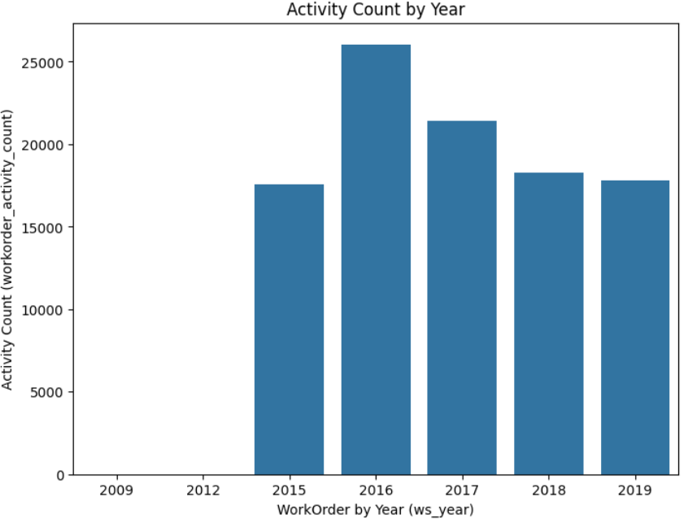
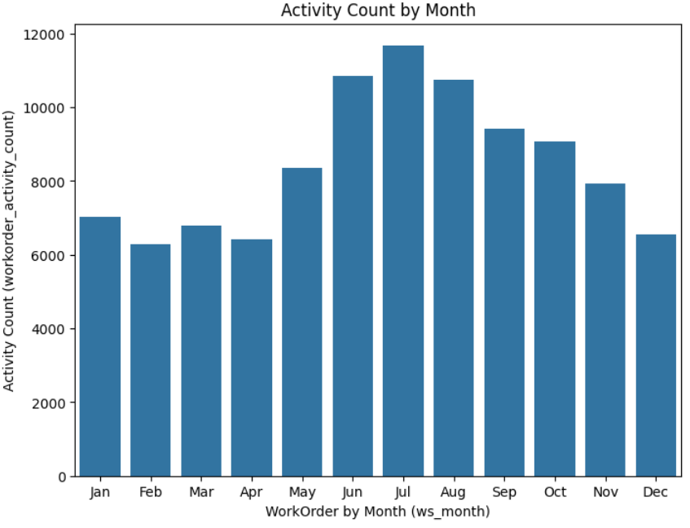
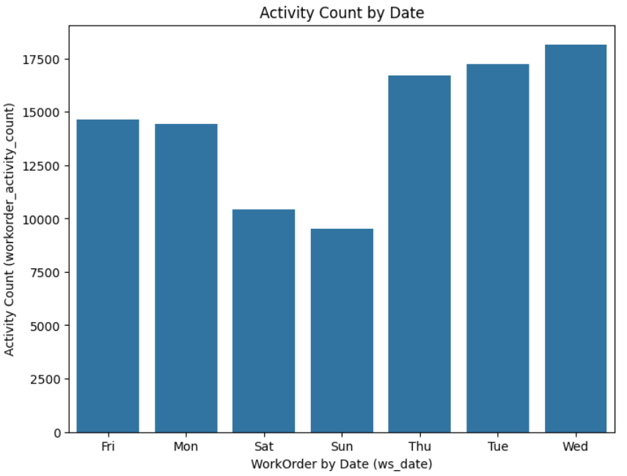
WORK ORDER DISTRIBUTION ANALYSIS
Use Case Definition: Understanding year-over-year patterns of work orders
Recommended Insights: Develop long-term service strategies for improved service delivery

Slide 6
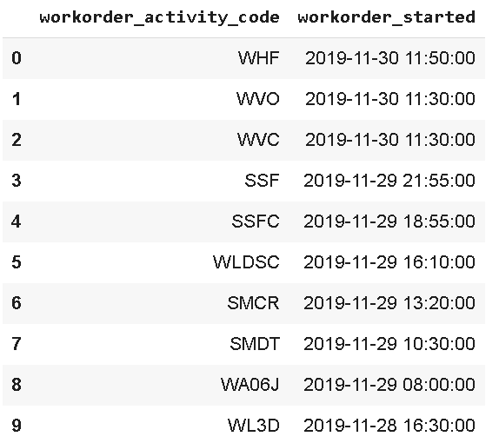
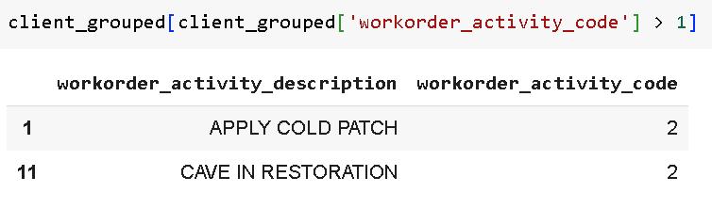
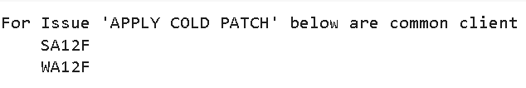
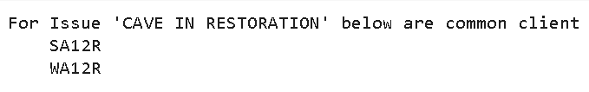
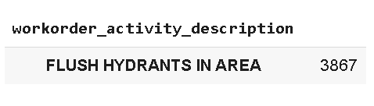
CLIENT SPECIFIC ANALYSIS
Use Case Definition: Understanding client needs and similar issues to improve service delivery
Recommended Insights: Create standardized response protocols for common cross-client issues and maintenance schedules based on recurring patterns
Recent clients
Clients facing common issues
Frequent task for “WHF”

Slide 7

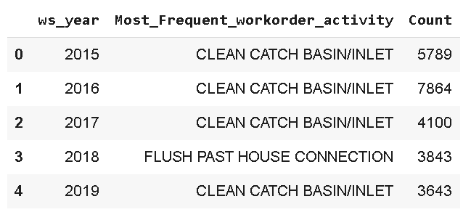
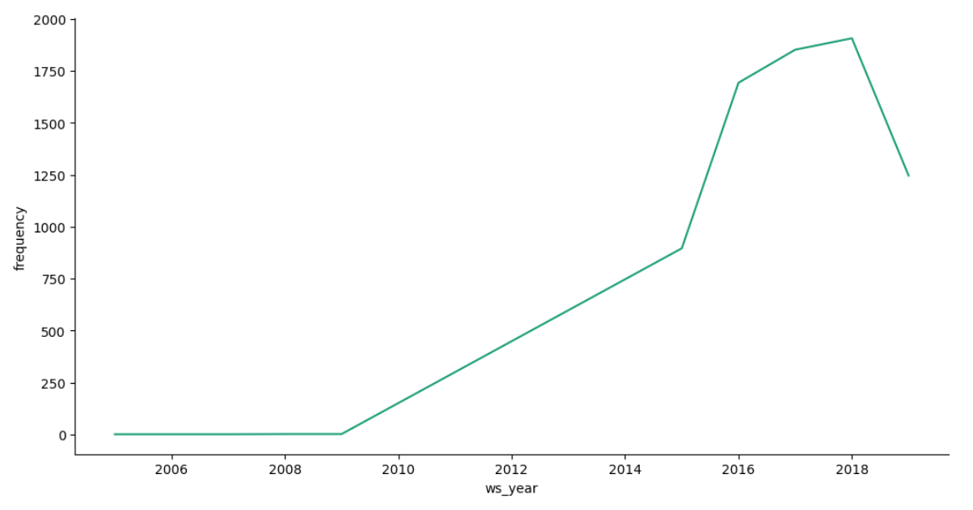
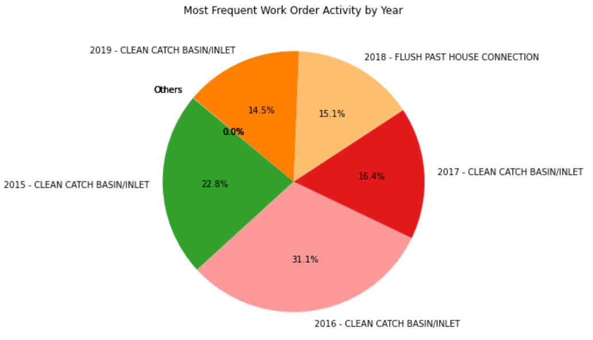
CLIENT LONGEVITY ANALYSIS
Use Case Definition: Understanding year-over-year patterns and long-term client relationships
Recommended Insights: Develop long-term service strategies for long-standing clients
Orders received through years
Client with long standing connection

Slide 8
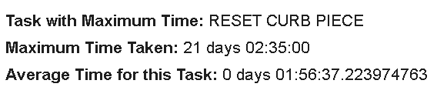
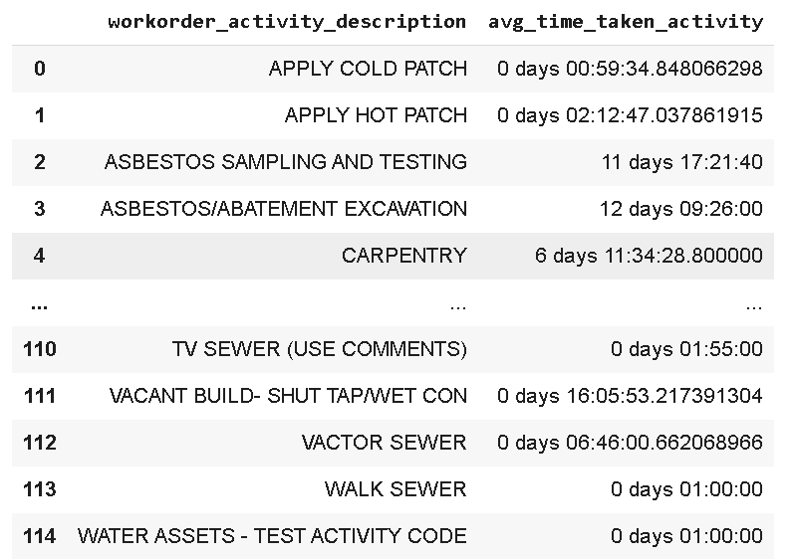
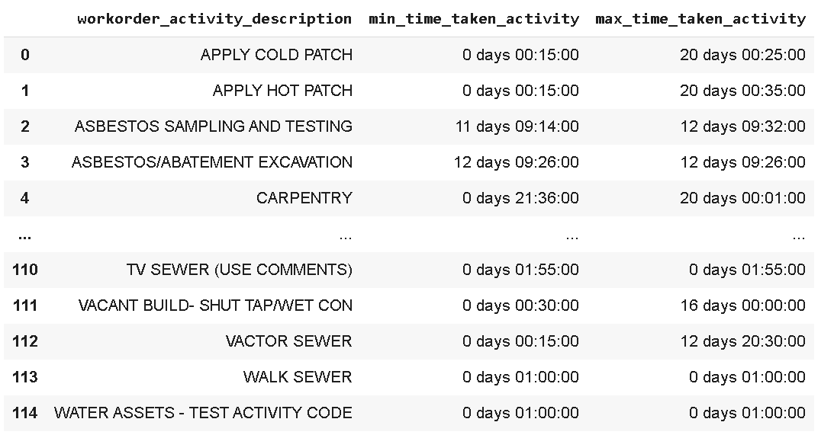
TIME BASED ANALYSIS
Use Case Definition: Understanding time requirements to improve scheduling and reduce delays
Recommended Insights: Optimize scheduling by task duration, identify tasks for process improvement, and implement targeted training for high-effort tasks
Task with max time
Average time for each task
Time range per task

Slide 9
Analysis & Planning
Process Enhancement
Client Focus Excellence
Continuous Improvement
Implementation Roadmap
Service Quality Indicators
Resolution Categories
Customer Feedback
Asset Intelligence
Equipment Data
Data Enhancement
Operational Metrics
Priority levels
Technician details
Resource Management
Cost data
Location Information

Slide 10
THANK YOU

